Slide 1
UCAT ANZ 2025
University Clinical Aptitude Test
Australia and New Zealand
ucat.edu.au

Slide 2
UCAT ANZ 2025 Overview…
What is the UCAT ANZ and who uses it?
Eligibility
Key Dates, Registration and Booking
Fees and Concessions
Access Arrangements
New Test Format
How should I prepare for the test?
Test Day
Results

Slide 3
What is the UCAT ANZ?
Admissions test used in the selection process by a consortium of universities in Australia and New Zealand for their medical, dental and clinical science degree programmes
No curriculum content; the test examines innate skills
Helps universities make more informed choices from amongst the many highly-qualified applicants
Used in collaboration with other admissions processes such as interviews and academic qualifications

Slide 4
What is the UCAT ANZ?
You sit the test in the same year that you apply to university
You can only sit the test once each year
2 hour, multiple-choice, computer-based test which you sit at a Pearson VUE test centre
The test can be sat in Australia, New Zealand and in test centres worldwide
Assesses a range of mental abilities across 4 separately timed subtests:
Verbal Reasoning
Decision Making
Quantitative Reasoning
Situational Judgement

Slide 5
UCAT ANZ Universities
University of Notre Dame Australia
Medicine Pathway (Sydney Campus)
The University of Queensland
Medicine (provisional entry pathway),
Dental Science
University of Southern Queensland
Medicine Pathway (provisional entry to UQ MD, Darling Downs-South West Medical Pathway)
University of the Sunshine Coast
Medicine Science (optional) (provisional entry pathway to MD program at Griffith University)
University of Tasmania
Medicine
The University of Western Australia
Doctor of Medicine via Bachelor of Biomedicine (Specialised),
Doctor of Dental Medicine via Bachelor of Biomedicine (Specialised)
Western Sydney University
Medicine (Joint Program in Medicine)
NEW ZEALAND
The University of Auckland
Medicine
University of Otago
Medicine
AUSTRALIA
University of Adelaide
Medicine, Dental Surgery, Oral Health
Central Queensland University
Medical Science (Regional Medical Pathway provisional entry to UQ)
Charles Sturt University
Dental Science, Medicine (Joint Program in Medicine)
Curtin University
Medicine
Flinders University
Clinical Sciences / Medicine
Griffith University
Dental Health Science (compulsory),
Medical Science (optional)
Monash University
Medicine
The University of Newcastle /
University of New England
Joint Medical Program
The University of New South Wales
Medicine

Slide 6
Eligibility
The UCAT ANZ test is only available to a candidate whose educational level at the time of sitting the test is that they are undertaking or have completed the final year of secondary schooling, or higher.
For example, candidates registering for UCAT ANZ 2025 should have completed, or plan to complete their final year of secondary schooling in 2025 (Year 12 in Australia; Year 13 in New Zealand).
Students in Australian Year 11 or New Zealand Year 12 candidates or lower are NOT eligible to sit the UCAT ANZ.
This includes Australian Year 11 students undertaking one or more Year 12 subjects. Year 12 students completing Year 12 over two years are only eligible to sit the UCAT ANZ in their final year.
Candidates are eligible to sit UCAT ANZ if they have commenced or completed an undergraduate degree.
It is noted, however, that not all undergraduate degree programs for which UCAT ANZ is a prerequisite will offer places for non-school leavers. Candidates are advised to check the UCAT ANZ Consortium university websites for further information.
Some UCAT ANZ Consortium universities require international students to sit UCAT ANZ. Candidates are advised to check the UCAT ANZ Consortium university websites for further information.
International candidates registering for UCAT ANZ 2025 should have completed, or plan to complete their final year of secondary schooling in 2025.

Slide 7
Key Dates 2025
Deadline times are 11:59pm Australian Eastern Standard Time (AEST)
3 February | Concession Scheme and Access Arrangements open
4 March | Booking opens
9 May (11:59pm AEST) | Concession Scheme deadline
16 May (11:59pm AEST) | BOOKING DEADLINE Access Arrangements applications close
30 May (11:59pm AEST) | Late booking deadline Late Access Arrangements application deadline
6 June (11:59pm AEST) | Final late booking deadline
11 June (11:59pm AEST) | Refund deadline
1 July | Testing begins
5 August | Last testing date
Early September | Results delivered to universities

Slide 8
Registration and Booking
Step 1
Visit the UCAT ANZ website and register your candidate account.
Step 2
If you are eligible for Access Arrangements and/or the Concession fee, apply and await approval before booking a test. These applications open on 3 February.
Step 3
Book your test from 4 March via your candidate account. The booking deadline is 16 May at 11:59pm AEST.
Ensure to read the information on the UCAT ANZ website thoroughly.

Slide 9
Fees
Tests taken in Australia and New Zealand | $325
Tests taken overseas (outside Australia and New Zealand) | $395
Concession fee (Australia only) | $240
Late fee (tests booked from 17 May – 30 May at 11:59pm AEST) | Additional $85
Final late fee (tests booked from 31 May – 6 June at 11:59pm AEST) | Additional $185
Refund fee | $50 deducted
Rescheduling fee (applies to rescheduling after 29 June 11:59pm AEST) | $25
All fees are given in Australian dollars. The late fees are non refundable.

Slide 10
Access Arrangements
Candidates with special educational needs, disabilities or medical conditions who receive exam accommodations for school/college/university exams may be entitled to access arrangements when sitting the UCAT ANZ.
Likely to relate to dyslexia, specific learning difficulties etc. but may apply to a range of other medical conditions.
The Access Arrangements page of our website details the different arrangements available and the online application form.
Applications for access arrangements open on 3 February 2025.
Applications should be submitted (with supporting evidence) by 16 May 2025.
Late applications submitted after 16 May are charged the late fee.
Late applications are accepted until 30 May.

Slide 11
Concession Fee
Candidates who are named on a current Australian Health Care Card (HCC) or Pensioner Concession Card (PCC), both issued by Centrelink, are eligible for a reduced test fee.
The concession fee is not available to candidates sitting the test outside Australia.
You will need to provide evidence to be eligible for this reduced fee.
Full details about the Concession Scheme, including eligibility criteria and the online application form, is on our website.
Concession applications are accepted from 3 February until 9 May 2025.

Slide 12
2025 UCAT ANZ – New Test Format
In 2025, the UCAT ANZ exam will have the following structure and timings. (The Abstract Reasoning subtest has been withdrawn.)
Subtest | Questions | Instruction section | Timing
Verbal Reasoning | 44 | 1 minute 30 seconds | 22 minutes
Decision Making | 35 | 1 minute 30 seconds | 37 minutes
Quantitative Reasoning | 36 | 2 minutes | 26 minutes
Situational Judgement | 69 | 1 minute 30 seconds | 26 minutes

Slide 13
22 minutes
44 questions
11 passages
Verbal Reasoning
The test assesses your ability to read and think carefully about information presented in passages and to determine whether specific conclusions can be drawn from information presented
You are not expected to use prior knowledge to answer the questions
Some questions assess critical reasoning skills, requiring candidates to make inferences and draw conclusions from information
For other questions you decide whether the statement provided follows logically from the information in the passage

Slide 14
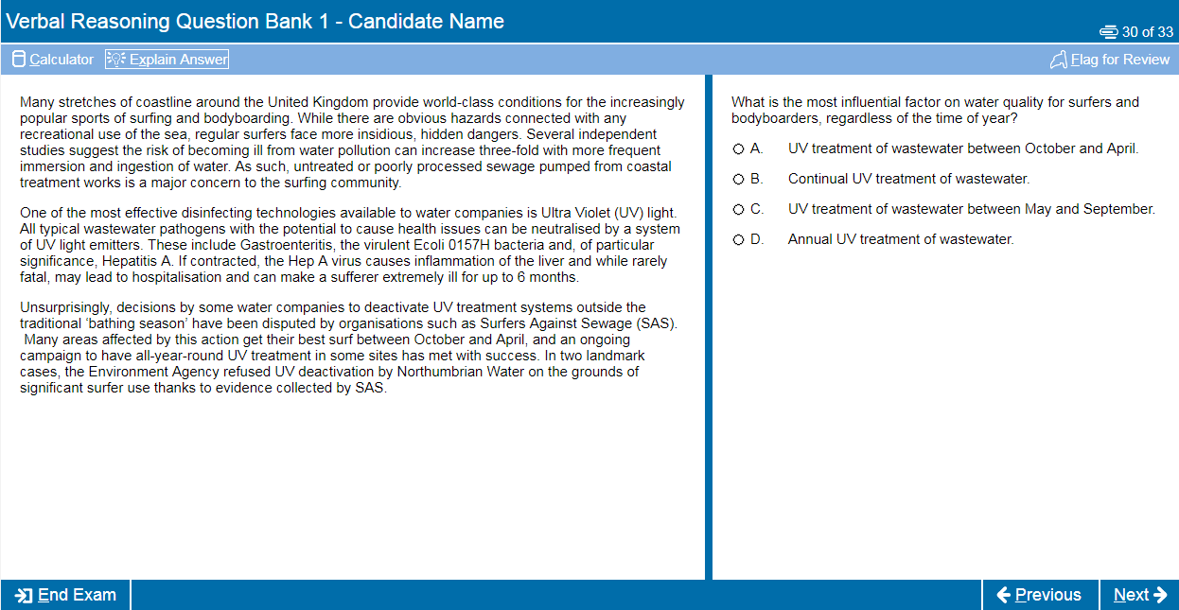

Slide 15
37 minutes
35 questions
Associated with diagrams, text, charts or graphs
Decision Making
This subtest assesses the ability to apply logic to reach a decision or conclusion, evaluate arguments and analyse statistical information
There are a number of different question types including logical puzzles, syllogisms and Venn diagrams
All questions are standalone and do not share data
You can make notes using the laminated notebook/noteboard and marker pen provided at the test centre

Slide 16
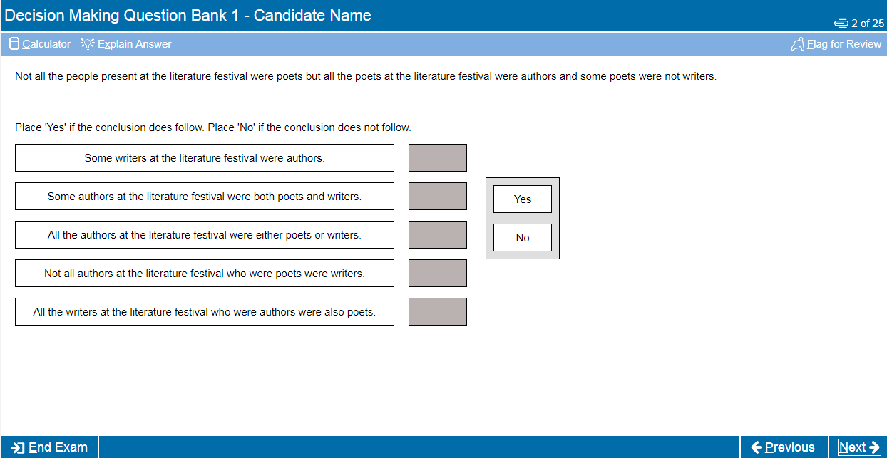

Slide 17
26 minutes
36 questions
Associated with tables, charts and/or graphs
Quantitative Reasoning
This subtest assesses your ability to use numerical skills to solve problems
It assumes familiarity with numbers, e.g. ratios, percentages, averages, fractions, etc.
A basic on-screen calculator is available for use in this section
You can make notes using the laminated notebook/ noteboard and marker pen provided at the test centre

Slide 18
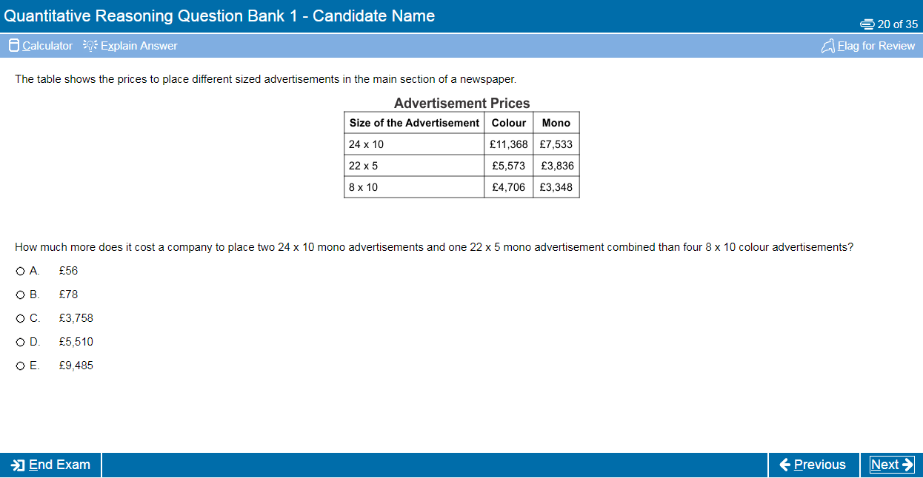

Slide 19
26 minutes
69 questions
Various scenarios
(with up to 6 associated questions)
Situational Judgement
The test measures your capacity to understand real world situations and to identify critical factors and appropriate behaviour in dealing with them
It assesses the key traits of integrity, perspective taking and team involvement, resilience and adaptability
SJTs are used widely in medical selection, including selection of Foundation Doctors, GPs and other medical specialties

Slide 20
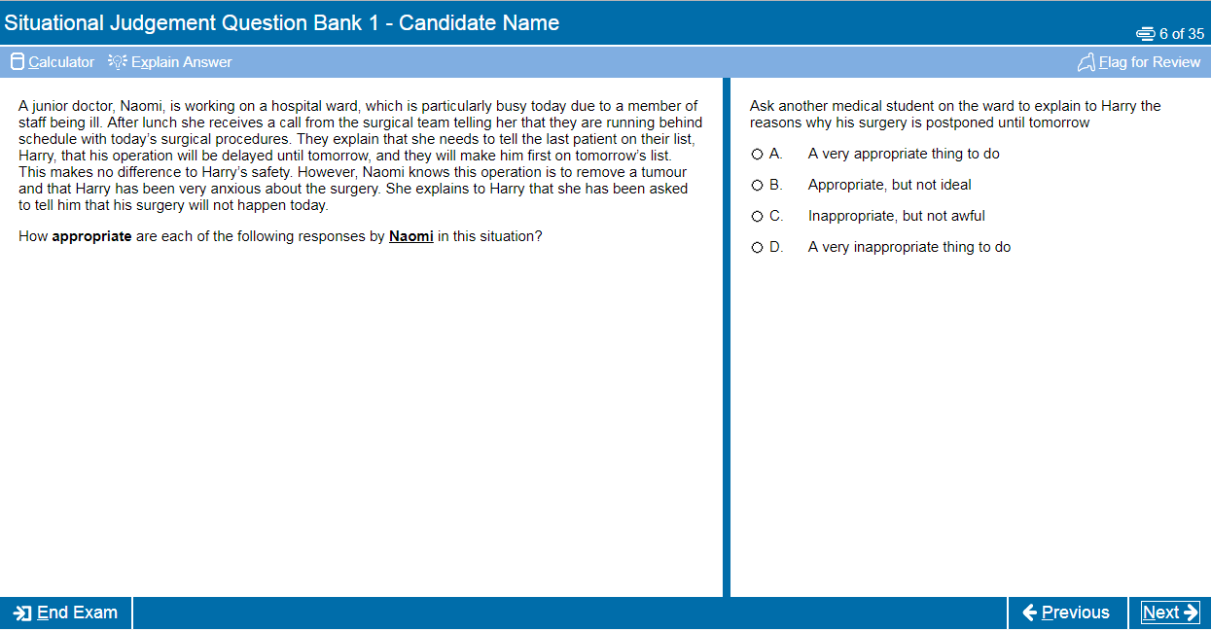

Slide 21
How should you prepare?
Although it is a test of aptitude rather than academic knowledge, you should still allow time to prepare thoroughly for the UCAT ANZ
Use the official FREE resources available on the UCAT ANZ website (we have over 1,000 example questions). Updated preparation materials for UCAT ANZ 2025 will be available in early March 2025.
We recommend you spend around 25-30 hours preparing for the test
Start at least 4-6 weeks before your test date
The UCAT ANZ consortium does not endorse or recommend any commercial preparation companies or materials. UCAT ANZ is not affiliated with these companies in any way.

Slide 22
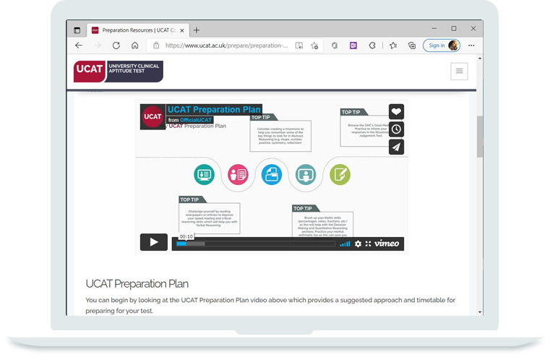
Practice Tests and Resources
Preparation Plan
Tour Tutorial
Question Tutorial
Question Banks
Practice Tests
Test Tools
Candidate Advice

Slide 23
Tips and Advice
Remember that no points are deducted for wrong answers so if you’re stuck use your best guess
Use the Flag and Review functions of the test effectively to manage your time
Use the official practice tests towards the end of your preparation to see where you need to manage your time more effectively
Practise the test timings, try to answer all the questions, don’t leave blanks

Slide 24
Test Day
Read the information on the Test Day page of the UCAT ANZ website.
Arrive at the Test Centre 30 minutes before your appointment time.
Make sure you take the correct ID or you will not be allowed to sit the test. Refer to the ID Policy on our website.
Read the UCAT ANZ Examination Rules carefully.
Other people will be testing in the same room as you so you may use earplugs if you wish. See the Test Day page for more information.
If you experience any issues during your test you must notify the invigilator immediately.

Slide 25
Scoring
Your UCAT ANZ result will comprise of a total score of between 900 and 2700 for the 3 cognitive subtests:
            Verbal Reasoning – 300 to 900
            Decision Making – 300 to 900
            Quantitative Reasoning – 300 to 900
            A separate score for Situational Judgement between 300 - 900

Slide 26
Results
UCAT ANZ 2025 results are valid for the 2025 university admissions cycle ONLY (for entry to university in 2026).
Results are available in your candidate account within 24 hours of sitting the test.
Before you submit your university application check how the universities use the test or you might be wasting an application.
We pass your results to the universities in early September 2025.
You do not need to tell us your application choices or pass your test result to your universities yourself.

Slide 27



THANK YOU!
For more information visit the UCAT ANZ website: ucat.edu.au
Follow UCAT ANZ on social media for important updates
@ucatofficialanz

