Slide 1
UCAT ANZ 2021
University Clinical Aptitude Test
www.ucat.edu.au

Slide 2
UCAT ANZ 2021 Overview…
What is the UCAT ANZ and who uses it?
Eligibility
Key Dates, Registration and Booking
Fees and Concessions
Access Arrangements
Test Format and Scoring
How should I prepare for the test?
Test Day
Results

Slide 3
What is the UCAT ANZ?
Admissions test used in the selection process by a consortium of universities in Australia and New Zealand for their medical, dental and clinical science degree programmes
No curriculum content; the test examines innate skills
Helps universities make more informed choices from amongst the many highly-qualified applicants
Used in collaboration with other admissions processes such as interviews and academic qualifications

Slide 4
What is the UCAT ANZ?
You sit the test in same year that you apply to university
You can only sit the test once each year
2 hour, multiple-choice, computer-based test which you sit at a Pearson VUE test centre
Assesses a range of mental abilities across 5 separately timed subtests
Verbal Reasoning
Decision Making
Quantitative Reasoning
Abstract Reasoning
Situational Judgement

Slide 5
UCAT ANZ Universities
University of Adelaide
Central Queensland University
Charles Sturt University
Curtin University
Griffith University
La Trobe University
Monash University
Flinders University
The University of Newcastle / University of New England
The University of New South Wales
The University of Queensland
University of Tasmania
The University of Western Australia
Western Sydney University
The University of Auckland
University of Otago

Slide 6
Eligibility
The UCAT ANZ test is only available to a candidate whose educational level at the time of sitting the test is that they are undertaking or have completed the final year of secondary schooling, or higher.
For example, candidates registering for UCAT ANZ 2021 should have completed, or plan to complete their final year of secondary schooling in 2021, that is, Year 12 in Australia or Year 13 in New Zealand.
Students in Australian Year 11 or lower are NOT eligible to sit the UCAT ANZ.
This includes Year 11 students undertaking one or more Year 12 subjects. Year 12 students completing Year 12 over two years are only eligible to sit the UCAT ANZ in their final year.
Candidates are eligible to sit UCAT ANZ if they have commenced or completed an undergraduate degree.
It is noted, however, that not all undergraduate degree programs for which UCAT ANZ is a prerequisite will offer places for non-school leavers. Candidates are advised to check the UCAT ANZ Consortium university websites for further information.
Only a limited number of UCAT ANZ Consortium universities require international students to sit UCAT ANZ and, if so, it will only be required in specific circumstances. Candidates are advised to check the UCAT ANZ Consortium university websites for further information.

Slide 7
Key Dates 2021
1 Feb | Concession Scheme and Access Arrangements open
1 March | Booking opens
10 May (11:59pm AEST) | Concession Scheme deadline
17 May (11:59pm AEST) | BOOKING DEADLINE Access Arrangements deadline
31 May (11:59pm AEST) | Late booking deadline
7 June (11:59pm AEST) | Refund deadline
1 July | Testing begins
11 August | Last testing date
By early September | Results delivered to universities

Slide 8
Registration and Booking
Step 1
Register your candidate account
Step 2
If you qualify for Access Arrangements and/or the Concession fee, apply and await approval before booking your test
Step 3
Book your test from 1 March via your candidate account.
The booking deadline is 17 May at 11:59pm AEST.

Slide 9
Fees
Tests taken in Australia and New Zealand | $305
Tests taken overseas (outside Australia and New Zealand) | $380
Concession fee (Australia only) | $199
Late fee (tests booked 18 May – 31 May at 11:59pm AEST) | $85
Refund fee | 15% of the total test fees deducted
All fees are given in Australian dollars.

Slide 10
Access Arrangements
If you are entitled to extra time or rest breaks for exams at school/college/university based upon a medical diagnosis or psychologist’s report we offer versions of the test which should meet your needs
Applications for access arrangements (with supporting evidence) must be approved by the UCAT ANZ Office and are accepted until 17 May 2021
Likely to relate to dyslexia, specific learning difficulties etc. but may apply to a range of other medical conditions
The Access Arrangements page of our website details the different accommodations we can support - please check to see what is available

Slide 11
Concession Fee
Candidates who are named on a current Australian Health Care Card (HCC) or Pensioner Concession Card (PCC) are eligible for a reduced test fee
The concession fee is not available to candidates sitting the test outside Australia
You will need to provide evidence to be eligible for this reduced fee
Full details on the Concession Scheme, including eligibility criteria and how to apply, are on our website

Slide 12
Test Format (UCAT ANZ)
Subtest | Questions | Timing
Verbal reasoning | 44 | 22 minutes
Decision making | 29 | 32 minutes
Quantitative reasoning | 36 | 25 minutes
Abstract reasoning | 55 | 14 minutes
Situational judgement | 69 | 27 minutes
Total Time |  | 120 minutes
*Timings include 1 min of instruction before each subtest

Slide 13
21 minutes
44 questions
11 passages
Verbal Reasoning
The test assesses your ability to read and think carefully about information presented in passages and to determine whether specific conclusions can be drawn from information presented
You are not expected to use prior knowledge to answer the questions
Some questions assess critical reasoning skills, requiring candidates to make inferences and draw conclusions from information
For other questions you decide whether the statement provided follows logically from the information in the passage

Slide 14
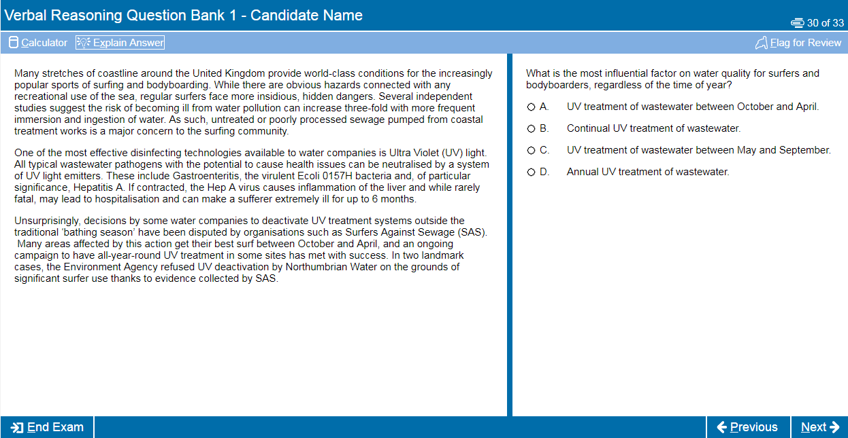

Slide 15
31 minutes
29 questions
Associated with diagrams, text, charts or graphs
Decision Making
This subtest assesses the ability to apply logic to reach a decision or conclusion, evaluate arguments and analyse statistical information
There are a number of different question types including logical puzzles, syllogisms and Venn diagrams
All questions are standalone and do not share data
You can make notes using a whiteboard / marker pen

Slide 16
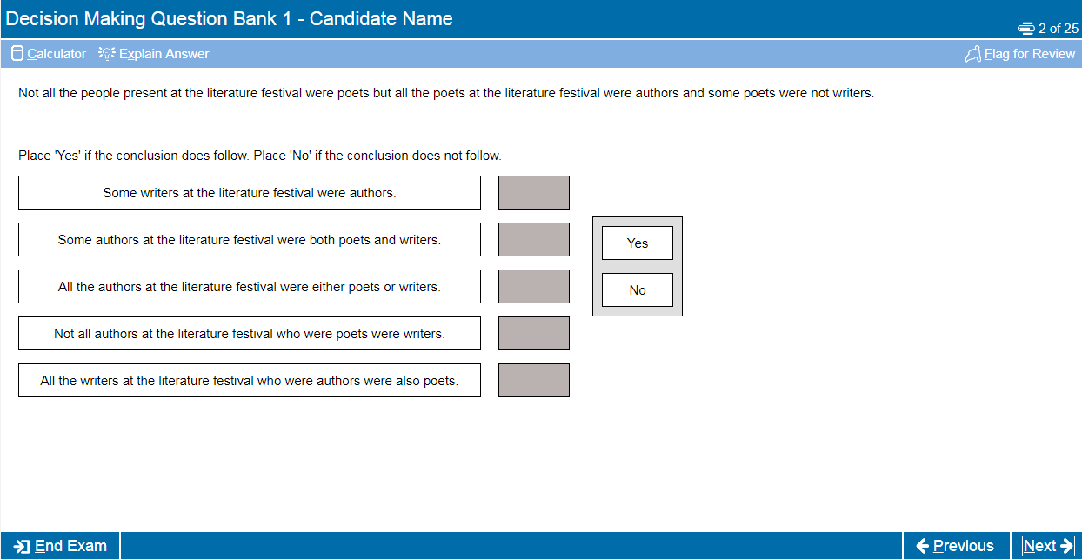

Slide 17
24 minutes
36 questions
Associated with tables, charts and/or graphs
Quantitative Reasoning
This subtest assesses your ability to use numerical skills to solve problems
It assumes familiarity with numbers, e.g. ratios, percentages, averages, fractions, etc.
A basic calculator is available for use in this section
You can make notes using a whiteboard / marker pen

Slide 18
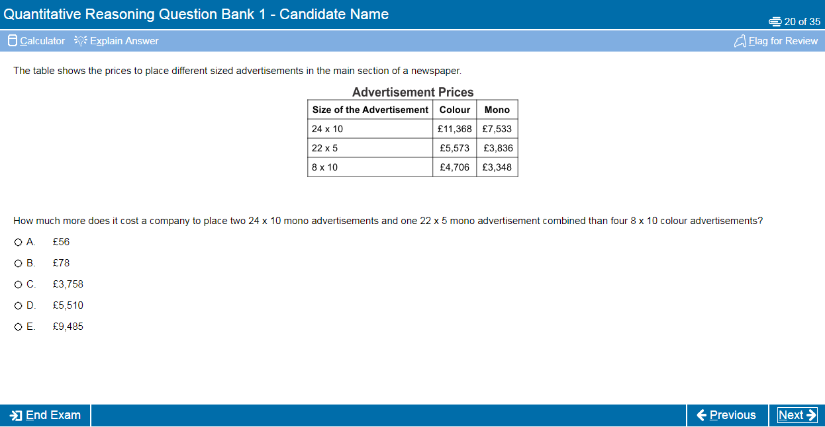

Slide 19
13 minutes
55 questions
Associated with numerous sets of shapes
Abstract Reasoning
The test assesses your ability to identify patterns amongst abstract shapes where irrelevant and distracting material may lead to incorrect conclusions
The test therefore measures your ability to change track, critically evaluate and generate hypotheses and requires you to query judgements as you go along
There are 4 different questions types in this test

Slide 20
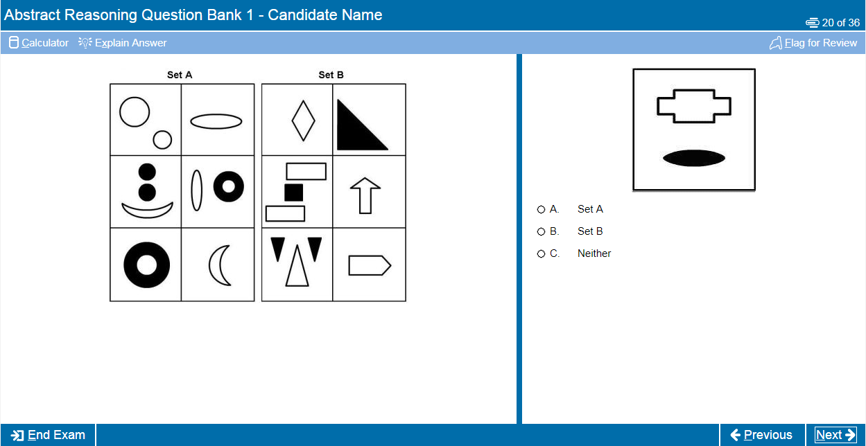

Slide 21
26 minutes
69 questions
22 scenarios
(with up to 6 associated questions)
Situational Judgement
The test measures your capacity to understand real world situations and to identify critical factors and appropriate behaviour in dealing with them
It assesses the key traits of integrity, perspective taking and team involvement, resilience and adaptability
SJTs are used widely in medical selection, including selection of Foundation Doctors, GPs and other medical specialties

Slide 22
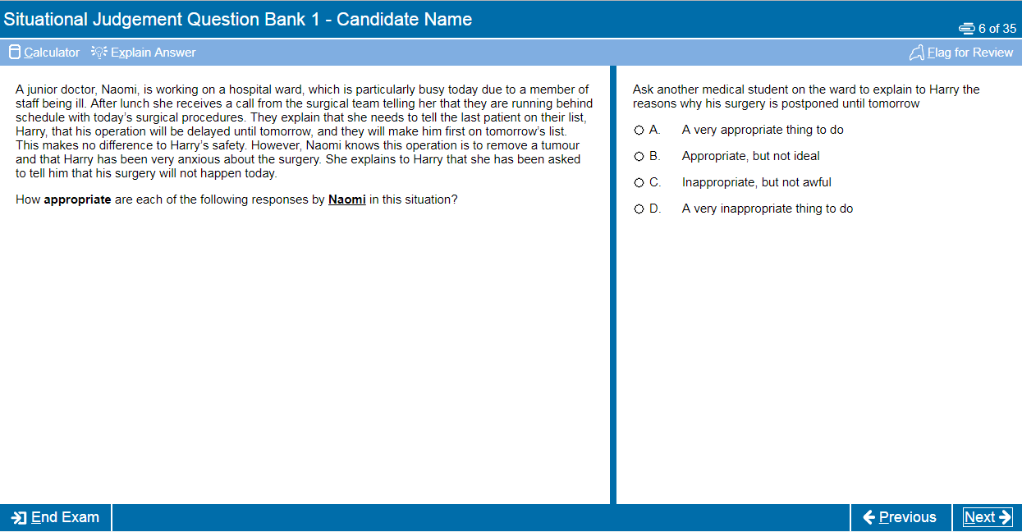

Slide 23
Scoring
Your UCAT ANZ result will comprise of a total score of between 1200 and 3600 for the 4 cognitive subtests:
            Verbal Reasoning – 300 to 900
            Decision Making – 300 to 900
            Quantitative Reasoning – 300 to 900
            Abstract Reasoning – 300 to 900
            A separate score for Situational Judgement between 300 - 900
The mean score for 2020 was 2527

Slide 24
How should you prepare?
Although it is a test of aptitude rather than academic knowledge, you should still allow time to prepare thoroughly for the UCAT ANZ
We recommend you spend around 25-30 hours preparing for the test
Start at least 4-6 weeks before your test date
Use the FREE resources available on the UCAT ANZ website (we have over 1,000 example questions)
Read the Practice Tips page of our website

Slide 25
Practice Tests and Resources
Preparation Plan
Tour Tutorial
Question Tutorial
Question Banks
Practice Tests
UCAT Official App

Slide 26
Tips and Advice
If you have not studied maths recently, revisit and practice these skills (QR & DM)
Brush up on your mental maths (QR)
Practice your speed reading skills (VR)
Don’t be fazed by Abstract Reasoning, although this may be new you’ll soon start to recognise patterns
Read the Good Medical Practice guides from the Medical Board of Australia, and Medical Council of New Zealand, if you are struggling with SJT
Practice using the online calculator

Slide 27
Tips and Advice
Practise the test timings, try to answer all the questions, don’t leave blanks
Remember that no points are deducted for wrong answers so if you’re stuck use your best guess
Use the Flag and Review functions of the test effectively to manage your time
Use the official practice tests towards the end of your preparation to see where you need to improve your speed / manage your time more effectively
The UCAT ANZ Consortium are not associated with companies offering commercial preparation for the UCAT ANZ and do not endorse their materials

Slide 28
Test Day
Arrive at the Test Centre at least 30 minutes before you are due to start - if you are late you may not be allowed to test
Make sure you take the correct ID or you will not be allowed to sit the test
Due to COVID-19 additional measures may be in place - we will provide information at our website
Read the Candidate Examination Rules carefully
Other people will be testing in the same room as you so you may use earplugs
If you experience any issues during your test you must notify the invigilator immediately

Slide 29
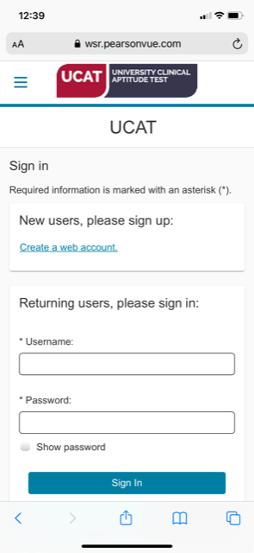
Results
UCAT ANZ 2021 results are valid for the 2021 university admissions cycle ONLY (for entry to university in 2022).
Results are available in your candidate account within 24 hours
Before you submit your university application check how universities use the test or you might be wasting an application
We pass your results to the universities by early September
You do not need to tell us your application choices or pass your test result to your universities yourself

Slide 30



THANK YOU!
For more information visit the UCAT website: ucat.edu.au
Follow UCAT ANZ on social media for important updates and information for 2021 testing
@ucatofficialanz

