Slide 1
UCAT ANZ 2019
University Clinical Aptitude Test
www.ucat.edu.au

Slide 2
This presentation covers…
What is the University Clinical Aptitude Test (UCAT) for Australia and New Zealand and who uses it?
The UCAT ANZ process
Eligibility
Key Dates, Registration and Booking
Fees and Concessions
What’s in the test?
How should I prepare for the Test?
Marking and Results
More information

Slide 3
What is the UCAT ANZ?
An admissions test used by a Consortium of universities in Australia and New Zealand for their medical, dental and clinical science degree programmes
Introduced in 2019 as a replacement for the UMAT (Undergraduate Medicine and Health Sciences Admission Test)
There is no curriculum content in the UCAT ANZ; the test examines innate skills
It helps universities to make more informed choices from amongst the many highly-qualified applicants who apply for their medical and dental degree programmes
It is used in collaboration with other admissions processes such as interviews and academic qualifications

Slide 4
What is the UCAT ANZ?
You sit the test in the same year that you apply to university
You can only sit the test once each year
2 hour, multiple-choice, computer based test which you sit at a local Pearson VUE test centre
It assesses a range of mental abilities across 5 separately timed subtests:
Verbal Reasoning
Decision Making
Quantitative Reasoning
Abstract Reasoning
Situational Judgement

Slide 5
UCAT ANZ Universities
The University of Adelaide
Charles Sturt University
Curtin University
Monash University
Flinders University
The University of Newcastle / University of New England
The University of New South Wales
The University of Queensland
University of Tasmania
The University of Western Australia
Western Sydney University
The University of Auckland
University of Otago

Slide 6
Eligibility
The UCAT ANZ test is available to any candidate whose educational level at the time of sitting the test is their final year of secondary schooling, or higher. Candidates registering for UCAT ANZ 2019 should have already completed, or plan to COMPLETE their final year of secondary schooling in 2019 (i.e. Year 12 in Australia; Year 13 in New Zealand).
Students whose current educational level is Australian Year 11 or lower are NOT eligible to take UCAT ANZ. This includes Year 11 students undertaking one or more Year 12 subjects. Year 12 students completing Year 12 over two years are only eligible to sit UCAT ANZ in their final year.

Slide 7
Key Dates 2019
1 Mar 2019 | - Registration and booking opens
1 Mar 2019 | - Concession scheme opens
10 May 2019 (5pm AEST) | - Concession deadline
10 May 2019 (5pm AEST) | - Access Arrangements application deadline
17 May 2019 (11.59pm AEST) | - Registration closes
17 May 2019 (11.59pm AEST) | - Final booking deadline
17 May 2019 (11.59pm AEST) | - Cancellation deadline
1 July 2019 | - Testing begins
31 July 2019 | - Last testing date
Early September 2019 | - Results delivered to universities

Slide 8
Registration & Booking
Register and create an online account so you can book your test
Book early to ensure places are available at your nearest test centre
Booking closes on 17th May 2019 at 11.59pm AEST

Slide 9
Test Fees
Tests taken in Australia or New Zealand: $298
Concession Fee (Australia only): $198
Tests taken overseas / outside Australia and New Zealand: $373

Slide 10
Concessions
Candidates who hold (or who are listed as a dependant on) a current Health Care Card (HCC) or Pensioner Concession Card (PCC) are eligible for a reduced test fee
The concession fee is not available to candidates sitting the test outside Australia
You will need to provide evidence to be eligible for this reduced fee
Full details on the Concession Scheme, including eligibility criteria and how to apply, are on our website

Slide 11
Access Arrangements
Candidates with special educational needs, disabilities or temporary injuries may be entitled to extra time or accommodations when sitting the test (UCATSEN ANZ = 25% Extra time)
Applications for these arrangements must be accompanied by suitable official documentation and be approved in advance
The deadline for submitting the online application form for Access Arrangements is 10 May 2019 at 5pm AEST

Slide 12
What is in the Test?
Verbal reasoning - assesses ability to critically evaluate information that is presented in a written form
Decision making - assesses ability to apply logic to reach a decision or conclusion, evaluate arguments & analyse statistical information
Quantitative reasoning - assesses ability to critically evaluate information presented in a numerical form
Abstract reasoning - assesses the use of convergent and divergent thinking to infer relationships from information
Situational judgement - measures capacity to understand real world situations and to identify critical factors & appropriate behaviour in dealing with them

Slide 13
Test Format
Subtest | Questions | UCAT ANZ (includes 1 min per subtest for instruction)
Verbal Reasoning | 44 | 22 minutes
Decision Making | 29 | 32 minutes
Quantitative Reasoning | 36 | 25 minutes
Abstract Reasoning | 55 | 14 minutes
Situational Judgement | 69 | 27 minutes
Total time |  | 120 minutes
Notes:
This is based on the standard UCAT, obviously timings for the SEN are extended by 25%

Slide 14
Verbal Reasoning
The test assesses your ability to read and think carefully about information presented in passages and to determine whether specific conclusions can be drawn from information presented. You are not expected to use prior knowledge to answer the questions
21 minutes to answer 44 items, associated with 11 passages
Some items assess critical reasoning skills, requiring candidates to make inferences and draw conclusions from information
For other items you decide whether the statement provided follows logically from the information in the passage

Slide 15
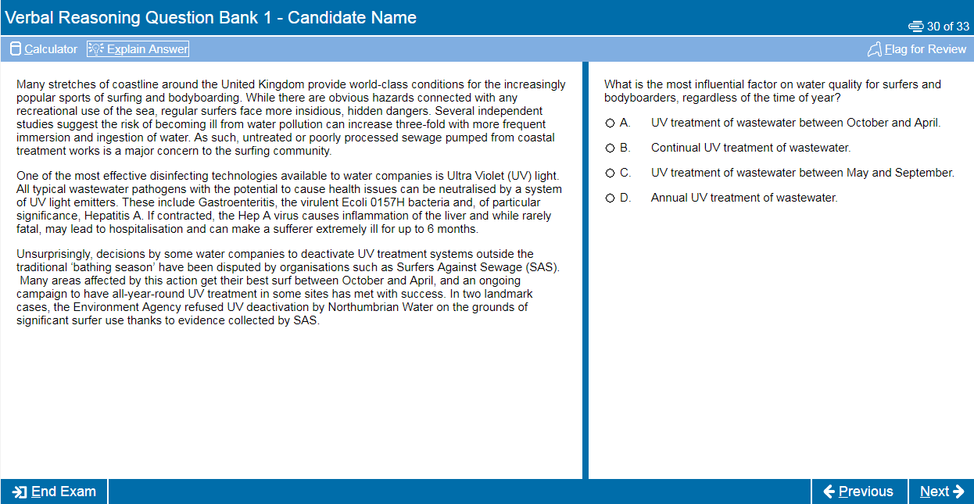
Verbal Reasoning

Slide 16
Verbal Reasoning

Slide 17
Decision Making
This subtest assesses the ability to apply logic to reach a decision or conclusion, evaluate arguments and analyse statistical information
31 minutes to answer 29 items, associated with diagrams, text, charts or graphs
There are a number of different question types including logical puzzles, syllogisms and Venn diagrams
All questions are standalone and do not share data

Slide 18
Decision Making

Slide 19
Decision Making

Slide 20
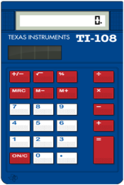
Quantitative Reasoning
The test assesses your ability to use numerical skills to solve problems
24 minutes to answer 36 items associated with tables, charts, and/or graphs
It assumes familiarity with numbers, e.g. ratios, percentages, averages, fractions, etc.
A basic calculator is available for use in this section

Slide 21
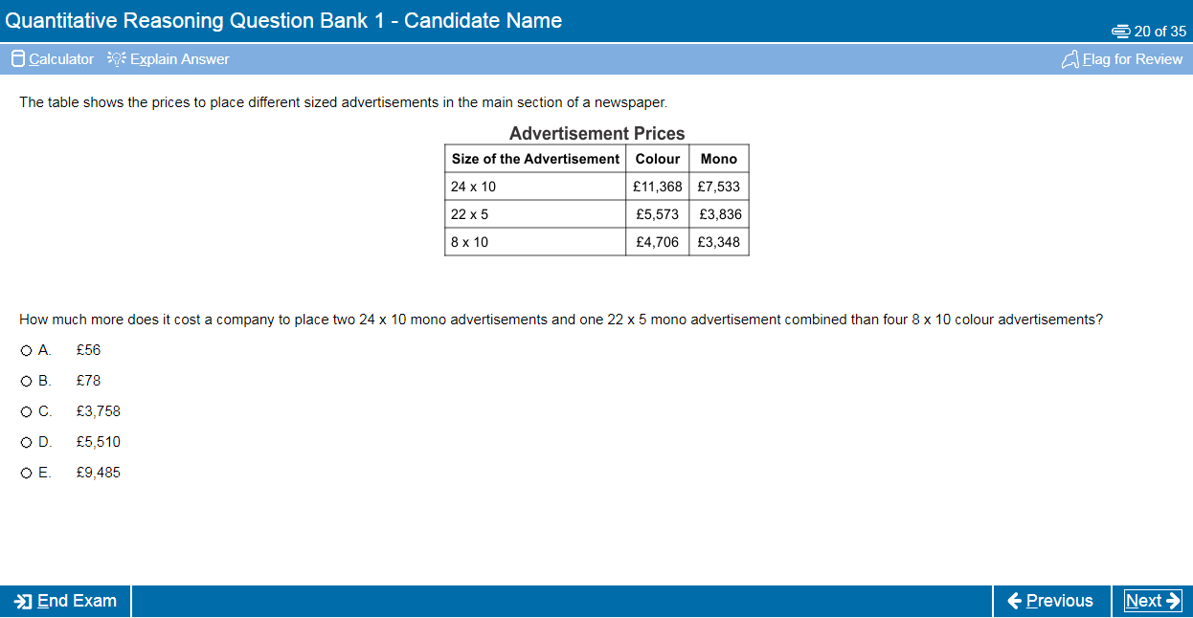
Quantitative Reasoning

Slide 22
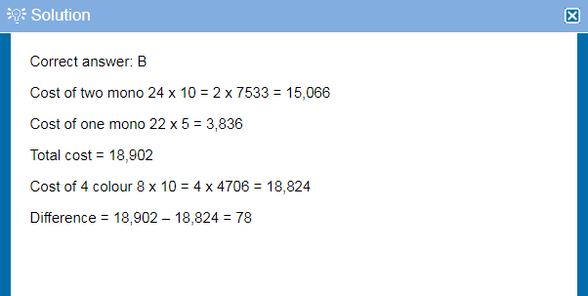
Quantitative Reasoning

Slide 23
Abstract Reasoning
The test assesses your ability to identify patterns amongst abstract shapes where irrelevant and distracting material may lead to incorrect conclusions
The test therefore measures your ability to change track, critically evaluate and generate hypotheses and requires you to query judgements as you go along
There are 4 different item types in this test
13 minutes to answer 55 items associated with sets of shapes

Slide 24
Abstract Reasoning

Slide 25
Abstract Reasoning

Slide 26
Situational Judgement
The test measures your capacity to understand real world situations and to identify critical factors and appropriate behaviour in dealing with them
It assesses the key traits of integrity, perspective taking and team involvement
SJTs are used widely in medical selection, including selection of Interns, GPs and other medical specialties
26 minutes to answer 69 items associated with 21 scenarios (consisting of between 2 and 6 response items)

Slide 27
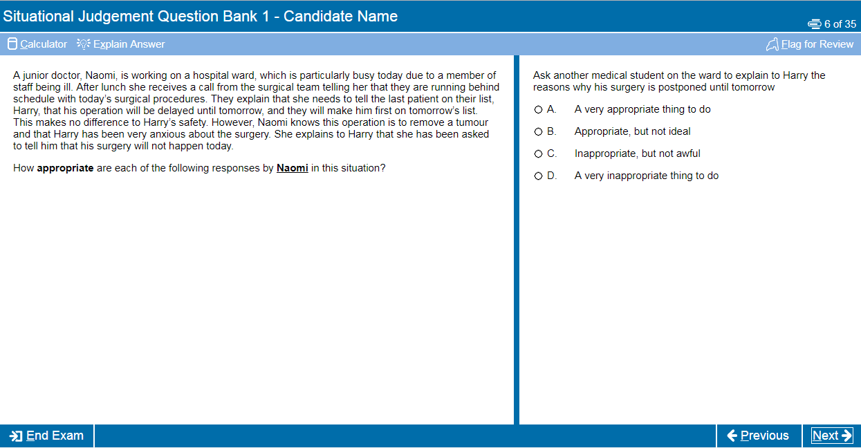
Situational Judgement

Slide 28
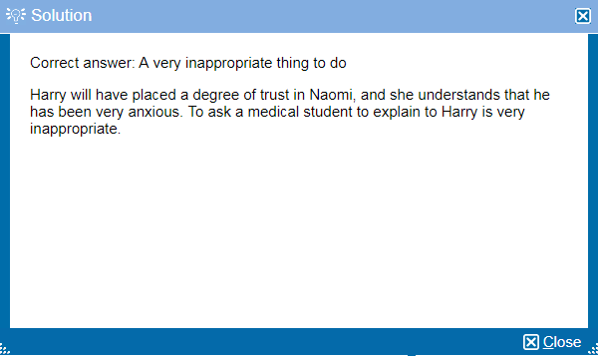
Situational Judgement

Slide 29
How should I prepare?
Although it is a test of aptitude rather than academic knowledge, you should still allow time to prepare thoroughly for the UCAT ANZ
We recommend you spend around 25-30 hours preparing for the test
Start at least 4-6 weeks before your test date
Use the FREE resources available on the UCAT website (we have over 1,000 example questions)

Slide 30
Practice Tests & Resources
Practice Tests
Essential to your UCAT preparation, 3 x fully timed practice tests which mimic the live test environment, important to understand time constraints
Question Banks
Hundreds of FREE example questions for each sub-test which are of equivalent standard to the real test
Tour Tutorial
Online tutorial which illustrations the functions of the computer based test, including how to Flag & Review questions
Question Tutorial
Interactive guide on how to approach each subtest, includes strategies for approaching the different question types within each section as well as handy hints and tips

Slide 31
Commercial Preparation Materials
Whilst there are many commercial companies offering coaching for the test, we do not work with any of these companies or endorse the use of their materials
Taking advantage of these opportunities can cost a great deal of money
We would advise you to be sceptical about claims they can help you do well in the test by coaching
Their materials and scoring may not necessarily be of the standard you will encounter in the UCAT
This may distort your performance whilst practising and give you misleading indicators of your anticipated score

Slide 32
Marking
Your UCAT result will comprise of a score of between 1200 to 3600 for the four cognitive subtests
Verbal Reasoning – 300 to 900
Decision Making – 300 to 900
Quantitative Reasoning – 300 to 900
Abstract Reasoning – 300 to 900
A separate score for Situational Judgement of between 300 - 900

Slide 33
Results
Results are available within 24 hours of your test sitting
Before you submit your university application check how universities use the test or you might be wasting an application
We will pass your results to our UCAT ANZ Consortium universities directly in early September

Slide 34
Validity of Results
UCAT ANZ Results are valid for the 2019 university admissions cycle ONLY (for entry to university in 2020).

Slide 35
More Information
Visit the UCAT ANZ website: www.ucat.edu.au
Follow UCAT ANZ on Twitter or Facebook to see reminders of deadlines, FREE example questions, revision tips, and get 2019 scores as soon as they are released
@UCATofficialANZ @UCATofficialANZ

